Slide 1
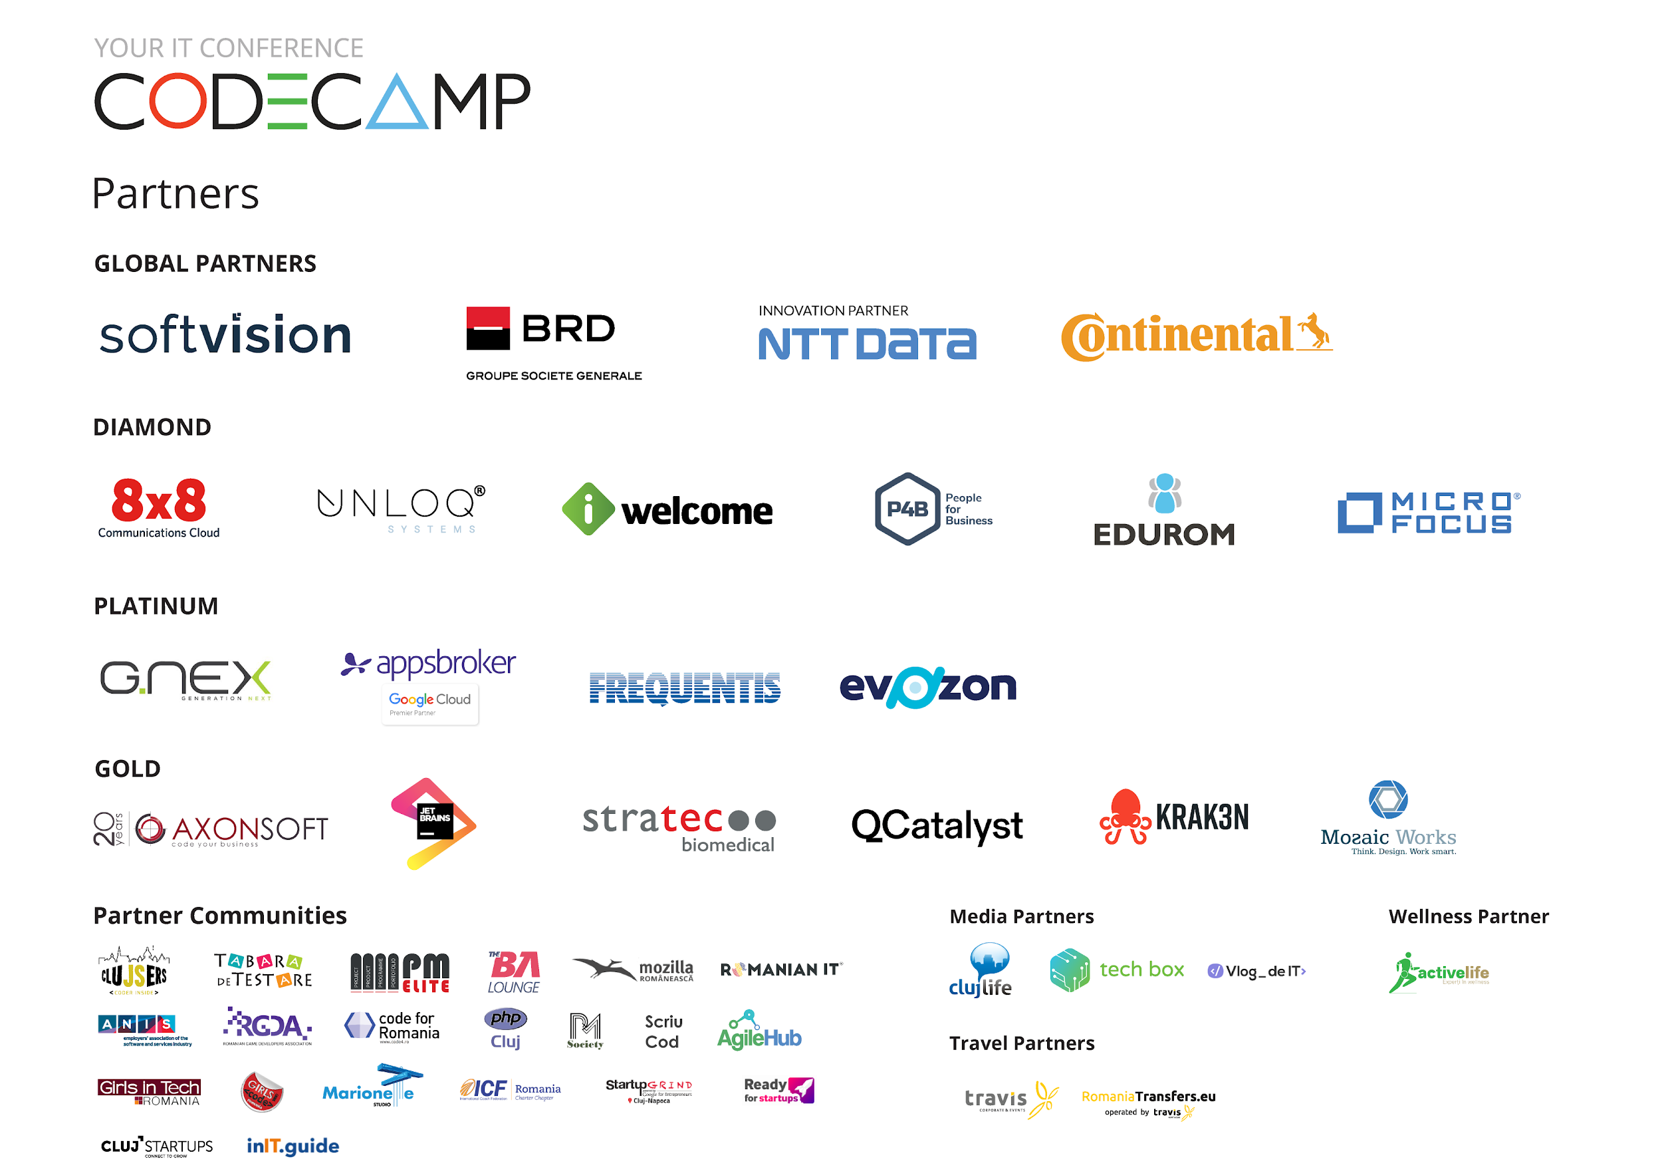

Slide 2
Building reusable components as micro-frontends
with GlimmerJS and WebComponents
Andrei Sebastian Cîmpean, @Andrei_Cimpean

Slide 3



Slide 4
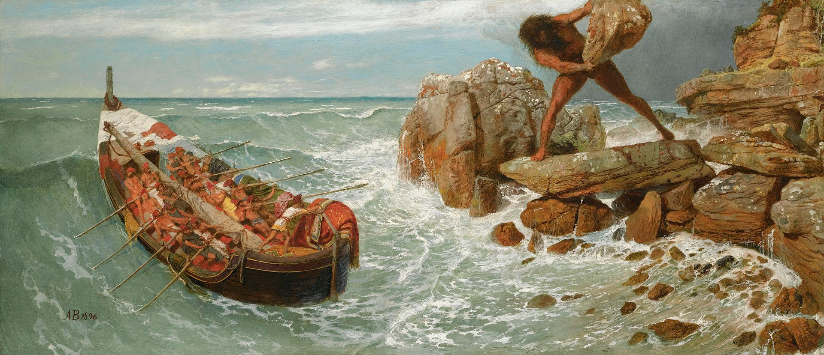
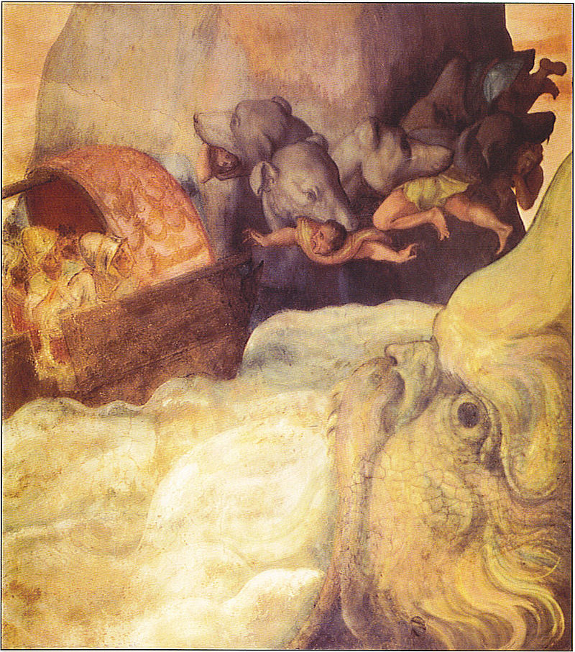
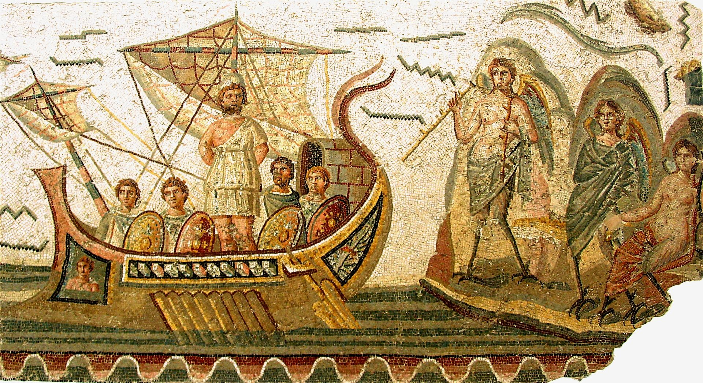
https://en.wikipedia.org/wiki/Odysseus#/media/File:Arnold_B%C3%B6cklin_-_Odysseus_and_Polyphemus.jpg
Odysseus and the Sirens, Ulixes mosaic at the Bardo National Museum in Tunis, Tunisia, 2nd century AD
Odysseus' ship passing between the six-headed monster Scylla and the whirlpool Charybdis, from a fresco by Alessandro Allori (1535–1607)

Slide 5
“Improve reusability to accelerate development”
THE MISSION

Slide 6
=> Very clear
architecture requirements
Reusability
Extensibility
Flexibility
Maintainability

Slide 7
Rich Frontend
Backend
Backbone + React
Server Application
Java
Js Framework
Angular, Ember
Server Application
Java
Vaadin/Java
.net
The simplified CCC tech

Slide 8
A common evolving tech stack of successful frontend apps
BackboneJS
Models
Views
Router
Sync (api communication)
BackboneJS
Models
Views
Router
Sync (api communication)
BackboneJS
Models
Views
Router
Sync (api communication)
ReactJS
View layer for new features
Components
ReactJS
View layer for new features
Components
Redux
State container
Used for new features
2012
Today
Notes:
Additive & in sync with the industry
Brownfield success story

Slide 9
Reusability
Horizontal reuse
assets that tend to be utilities that are generic to multiple applications (library)
Vertical reuse
assets that are typically business services, data services, business rules, etc.
https://artofsoftwarereuse.com/2009/10/13/key-differences-between-vertical-and-horizontal-reuse/
https://artofsoftwarereuse.com/2009/04/02/horizontal-and-vertical-software-assets/
Notes:
To achieve reusability in this context, a better understanding is required.
The more services are independent from one the more reuse and composition will be possible with those services.
vertical software assets are deliberately constructed as part of a product line.
Vertical reuse helps you create new products faster, offer product variations/flavors, and fetch a higher return on your software investments over super-generic horizontal assets.

Slide 10
Characteristic | Vertical Reuse | Horizontal Reuse
Applicability | Applications within a specific domain or closely related domains | Applicable across the board for application regardless of domain
Stakeholders | Business stakeholders and technology | Primarily technology. In some cases support teams provide input.
Variability | Varies from well-defined to open ended depending on the complexity of the domain. Variations may not be accurately captured in reusable assets. | More well defined than open-ended.
https://artofsoftwarereuse.com/2009/10/13/key-differences-between-vertical-and-horizontal-reuse/

Slide 11
Horizontal reuse via “core” library is common
A core library can contain:
Reusable presentation components ( inputs with labels, tables, application menu, etc.) with styling
Mixins
Templates
jQuery extensions
Base classes meant for extension
Reusable functionality (log in, tracking, event bus, etc.)
...
Application
Application
Core library
Notes:
If this was compared to definitions of vertical and horizontal reuse it could be described as a unplanned combination of both

Slide 12
Horizontal reuse via “core” library is common
A core library:
Leads to unpredictable results because it provides mostly reusable parts that would be integrated as it makes sense to each application
Doesn’t enforce consistency
Versioning, if attempted, is not trivial
Limits tech stack choices
Application
Application
Core library
Notes:
If this was compared to definitions of vertical and horizontal reuse it could be described as a unplanned combination of both

Slide 13
Reusable “core” lib is tricky when you have a large number of successful applications
Vaadin/Java
Backbone
React
Backbone
React
.net
Core
Js Framework
Angular, Ember
A “core” library that only works with some of our current-gen apps, it was extracted some time ago to help reduce the number of features reimplemented for each application.
Notes:
Focus and intent is to find software assets that are reusable across most or all your applications. Finding assets that are universally reusable is not only difficult but also will make your design overly complex.

Slide 14
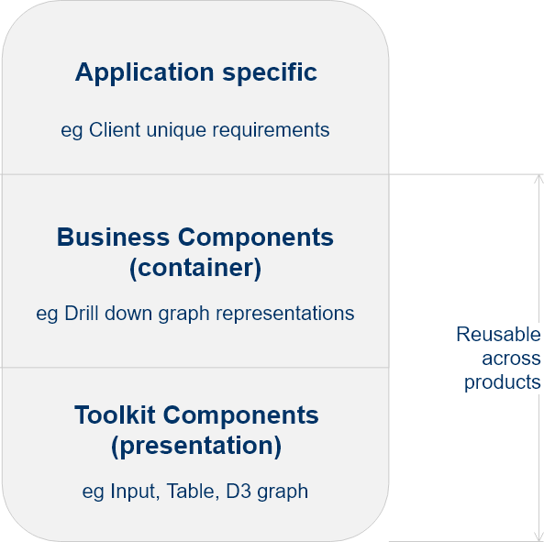
First go at Reusable components
Application specific are container components that implement business requirements using presentation components. These are unique per application and can be considered not portable.
Business Component are extracted from existing application specific components and are, to a degree, portable between applications.
Toolkit Components are immediately available in any application.

Slide 15
Common ways of building web apps in our industry
Frontend
Team
Single Page Application
[Frontend Team]
Single Page Application
[Frontend Team]
Backend
Team
Server Application
[Backend / Devops Team]
Aggregation Layer
[BFF, GraphQL]
Team Feature
[Specific mission]
Team Feature
[Specific mission]
Team Feature
[Specific mission]
Service
[Backend / Devops]
Service
[Backend / Devops]
Devops
Team
API + RICH CLIENT
SOA + RICH CLIENT
FEATURE TEAMS
USING
MICRO-FRONTENDS

Slide 16
Reusing JS, HTML and CSS independent of tech stack

Slide 17
WebComponents
Vaadin/Java
Backbone
React
Backbone
React
Standard with strict boundaries that works with any tech stack.
En ensemble of open web technologies that permit the creation of reusable user interface widgets.
https://www.webcomponents.org/specs
.net
WebComponent
Js Framework
Angular, Ember

Slide 18
The WebComponents standard
Web components are based on four main specifications:
Custom Elements
The Custom Elements specification lays the foundation for designing and using new types of DOM elements.
Shadow DOM
The shadow DOM specification defines how to use encapsulated style and markup in web components.
HTML imports
The HTML imports specification defines the inclusion and reuse of HTML documents in other HTML documents.
HTML Template
The HTML template element specification defines how to declare fragments of markup that go unused at page load, but can be instantiated later on at runtime.

Slide 19
The WebComponents standard is plagued with problems
Polymer is moving to Javascript modules because the current HTML Import spec is dead
Chrome implemented features eagerly but most browsers don’t agree on the implementation specifications
Chrome 36+/Opera 20+ implemented a previous version of Custom Elements (v0) that used .registerElement(). Other browsers are implementing v1, window.customElements.define().
Shadow DOM is considered for implementation by IE team
HTML Templates are the best supported but they are a lot slower than framework specific templates (handlebars, react code)
Notes:
But HTML Imports have not gotten traction among the standards committees or other browsers. There are active discussions on a successor, but any new standard would be years away.
https://hacks.mozilla.org/2015/06/the-state-of-web-components/

Slide 20
GlimmerJS
Glimmer.js is an open source JavaScript library for building UI components for the web.
It is built on the same rendering engine as Ember.js. It’s a UI layer—no routing, data loading, or other features.
Glimmer components can be booted up as Web Components.
https://glimmerjs.com/
https://engineering.linkedin.com/blog/2017/12/the-glimmer-binary-experience
Notes:
It’s similar to Preact/React but compiles an application’s HTML templates into compact bytecode instead of building a Virtual DOM.

Slide 21
Glimmer was created primarily as a tool for building mobile Progressive Web Applications and the exporter was an extra feature enabled by the small size.
The community is still discussing the strategy for delivering web components [1]. However, the current implementation is sufficient for our goal of authoring sharable components between different tech stacks.
https://github.com/glimmerjs/glimmer-web-component/issues/19

Slide 22
Ember-CLI
It’s a command line utility that provides an asset pipeline, a strong conventional project structure, and a powerful addon system for extension
It ships with support for blueprints. Blueprints are snippet generators for entities and it’s trivial to create custom ones
https://ember-cli.com/

Slide 23
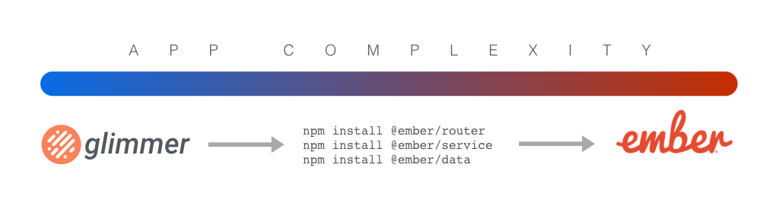
In the future*: npm install our way to Ember
*No date, but an important target of the community and in progress
https://github.com/emberjs/ember.js/issues/16301

Slide 24
WebComponents
With GlimmerJS
Vaadin/Java
Backbone
React
Backbone
React
Glimmer doesn’t produce web components based on standards in draft, it’s simply replacing a custom element with appropriate HTML generated by the Glimmer library.
In the future, we can use Glimmer components in Ember without having to compile them as WebComponents first.
.net
GlimmerJS Applications
as WebComponent
Js Framework
Angular
Potentially use without wrapping as WebComponent
EmberJS

Slide 25
Integration into web apps
Render and forget
Events and properties
Redux
EventBus

Slide 26
We follow selectively the Google best practices for working with web components
We follow events 100%:
Dispatch events in response to internal component activity.
Do not dispatch events in response to the host setting a property (downward data flow).
We ignore recommendations for shadow DOM and styling.
We selectively follow recommendations for Attributes and properties.
[1] https://developers.google.com/web/fundamentals/architecture/building-components/best-practices

Slide 27

Configuration:
Uploader for API request
Things to consider:
Auth works out of the box if you use cookies
Need to provide loading states and error states
HTTP caching
Need strategy for layout styling
PlaylistViewer
Component
Sub-Component
Sub-Component
Sub-Component
Sub-Component

Slide 28
Google recommends[1] that developers should aim to keep primitive data attributes and properties in sync, reflecting from property to attribute, and vice versa.
We don’t support this at the moment and don’t intend to:
Partially because it’s complex to implement
Partially because of a Glimmer limitation
It’s a tradeoff that works because we’re using web components as application parts that receive read-only configuration from parent and have internal state.
[1] https://developers.google.com/web/fundamentals/architecture/building-components/best-practices

Slide 29
Important GlimmerJS limitations and mitigations
Can’t pass HTML attributes to the web component | https://github.com/glimmerjs/glimmer-web-component/issues/19 Because Glimmer replaces the custom element with HTML it manages. We’re using a simple workaround.
Incomplete support for writing component tests | Big problem. We’re biting the bullet.
Very small ecosystem | Surprisingly small problem because we’re building small application parts.
Glimmer components are not 100% supported in Ember

Slide 30
Working with complex data
Internally we use the “Data Down, Action Up” principle.
We accept rich data (objects, arrays) through method calls or properties using the DOM and we don’t reflect them.
Redux is not our default option but we support hot-swapping the internal store with one supplied by the host application.
Host Redux Store
Configuration
External Event
Application
Components
Sub-Component
Sub-Component
Sub-Component
Sub-Component

Slide 31
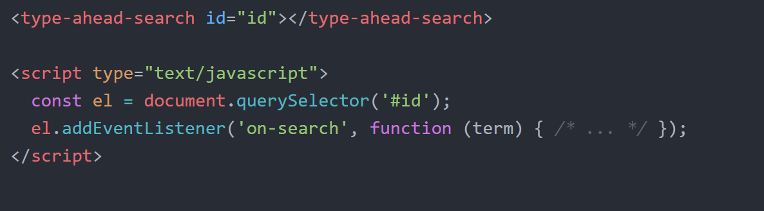
“External events” are CustomEvents.
In this case, the webcomponent would send a complex object describing the option the user selected.
https://developer.mozilla.org/en-US/docs/Web/API/CustomEvent
Notes:
CustomElements can’t be self-closing
https://developers.google.com/web/fundamentals/getting-started/primers/customelements
https://html.spec.whatwg.org/multipage/syntax.html#void-elements

Slide 32
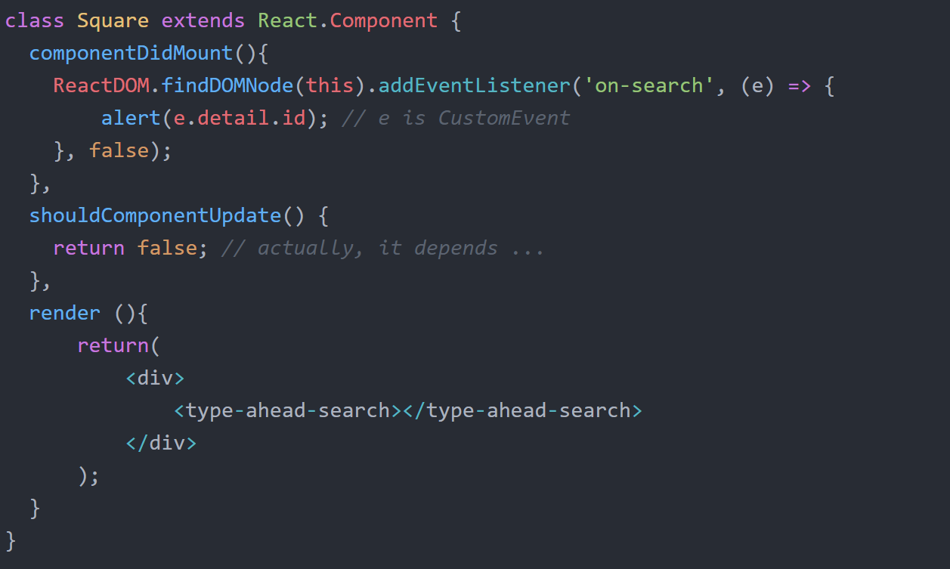
We use a React.Component wrapper that:
Sets configuration as HTML attributes
Listens to CustomEvents dispatched by the webcomponent and maybe maps them to callbacks
Controls re-rendering

Slide 33
Strategy for communication with the backend service

Slide 34
Backend For Frontend
iOS Mobile Client
Desktop Client
It’s a proxy between services and a specific device.
It is tightly coupled to a specific user experience and is typically maintained by the same team as the user interface.
https://samnewman.io/patterns/architectural/bff/
Mobile
Client
BFF
Desktop Client
BFF
Notes:
GRAPHQL is an alternative

Slide 35
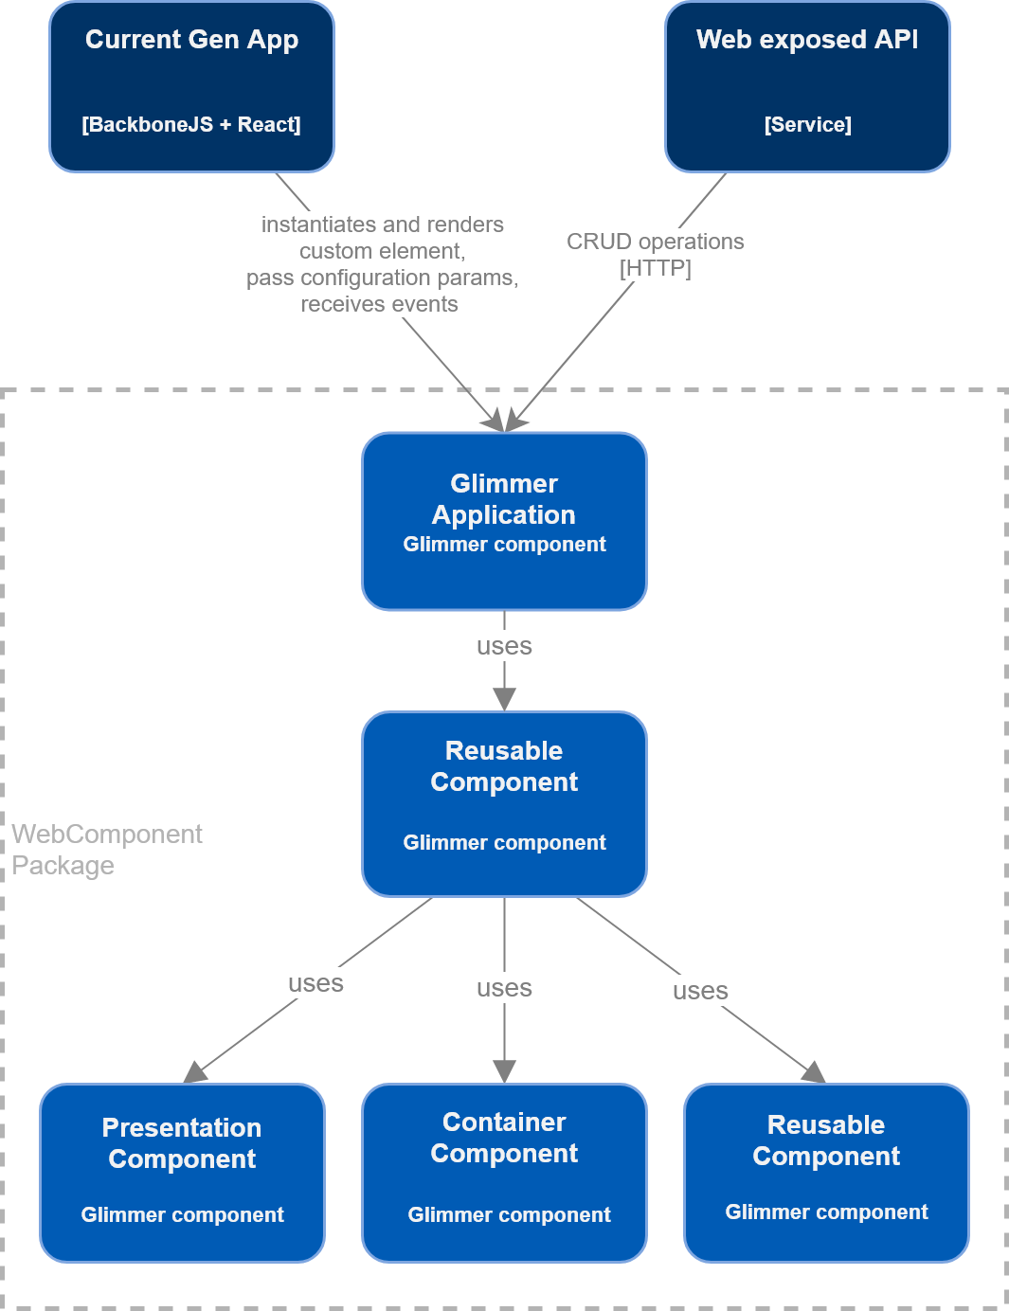
Micro-frontends
WebComponents + BFF

Slide 36
Logical architecture
Service-1
ccc-application-[ver]
Launch & Configure
reusable-comp-[ver]
Invoke
comp-service-[ver]
Service-2
Invoke
Service-3

Slide 37
Maybe almost Micro-frontends
“In this approach, the web application is broken down into its features, and each feature is owned, frontend to backend, by a different team. This ensures that every feature is developed, tested and deployed independently from other features.
Multiple techniques exist to recombine the features — sometimes as pages, sometimes as components — into a cohesive user experience.”
Thoughtworks tags this as Trial https://www.thoughtworks.com/radar/techniques/micro-frontends

Slide 38
Opportunities
Glimmer can bundle multiple WebComponents in the same file
Serverless computing / FASS
Full-stack development of application parts
...

Slide 39
Showcase?
Using https://github.com/puikinsh/sufee-admin-dashboard

Slide 40
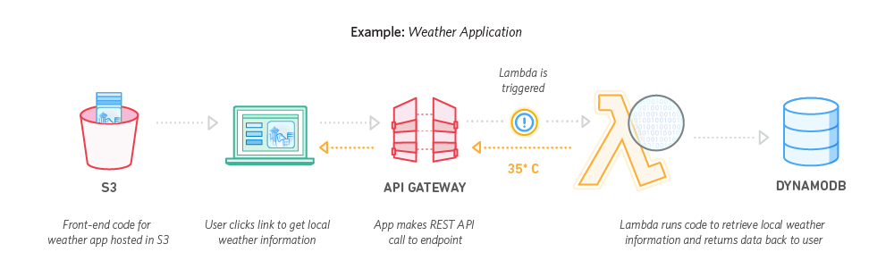
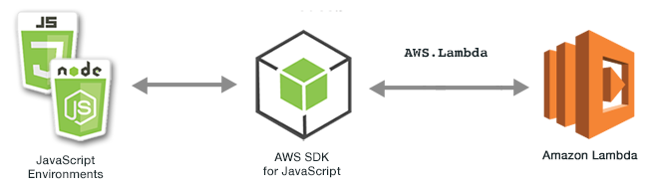

Slide 41
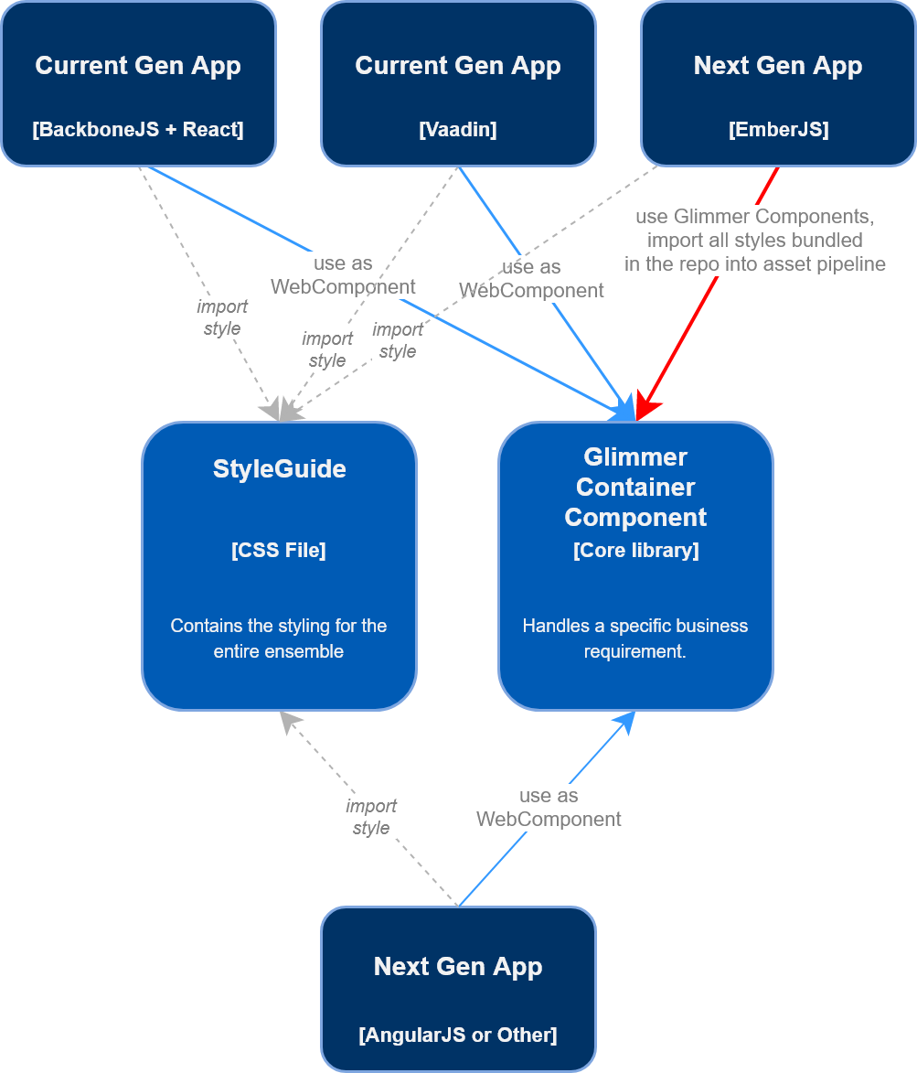
In regards to styling
Application Suites have a consistent look & feel
Micro-frontends can very easily have noticeably different look and feel
Most developers hate CSS
We decided to implement a styleguide put together by designers as a SASS library

Slide 42
Styleguide implementation
We created an ember-cli addon and custom blueprint to standardize the creation of style files.
We want to bundle the built css style file with the sass source code because we expect users to pipe what they use through a build process.
We don’t have a clear strategy at the moment beyond horizontal reuse (theming, integration, layout strictness, etc).

Slide 43
Style Guide
We’re applying BEMIT
Inverted Triangle CSS architecture. BEM + ITCSS = BEMIT
Small additions to BEM for usage and state information ( namespaces, responsive prefixes )
We expect that application developers will import placeholders when they reference a specific sass file, not the classname
SASS Placeholder
%ccc-input
Class
.ccc-input
Theme
Sass lists
@extends
use
Object
o-
Component
c-
Utility
u-
Theme
t-
Scope
t-
...

Slide 44
Putting everything together

Slide 45
Github
Artifactory
EC2
reusable-styles
build
reusable-styles-[ver]
microfrontend
build
microfrontend-[ver]
Npm dependency
optional
feature-interface
build
feature-interface-[ver]
feature-service
build
feature-service-[ver]
deploy
feature-service-[ver]
application
build
application-[ver]
deploy
application-[ver]
Notes:
Artifact interactions

Slide 46
Questions?

Slide 47


